Slide 1

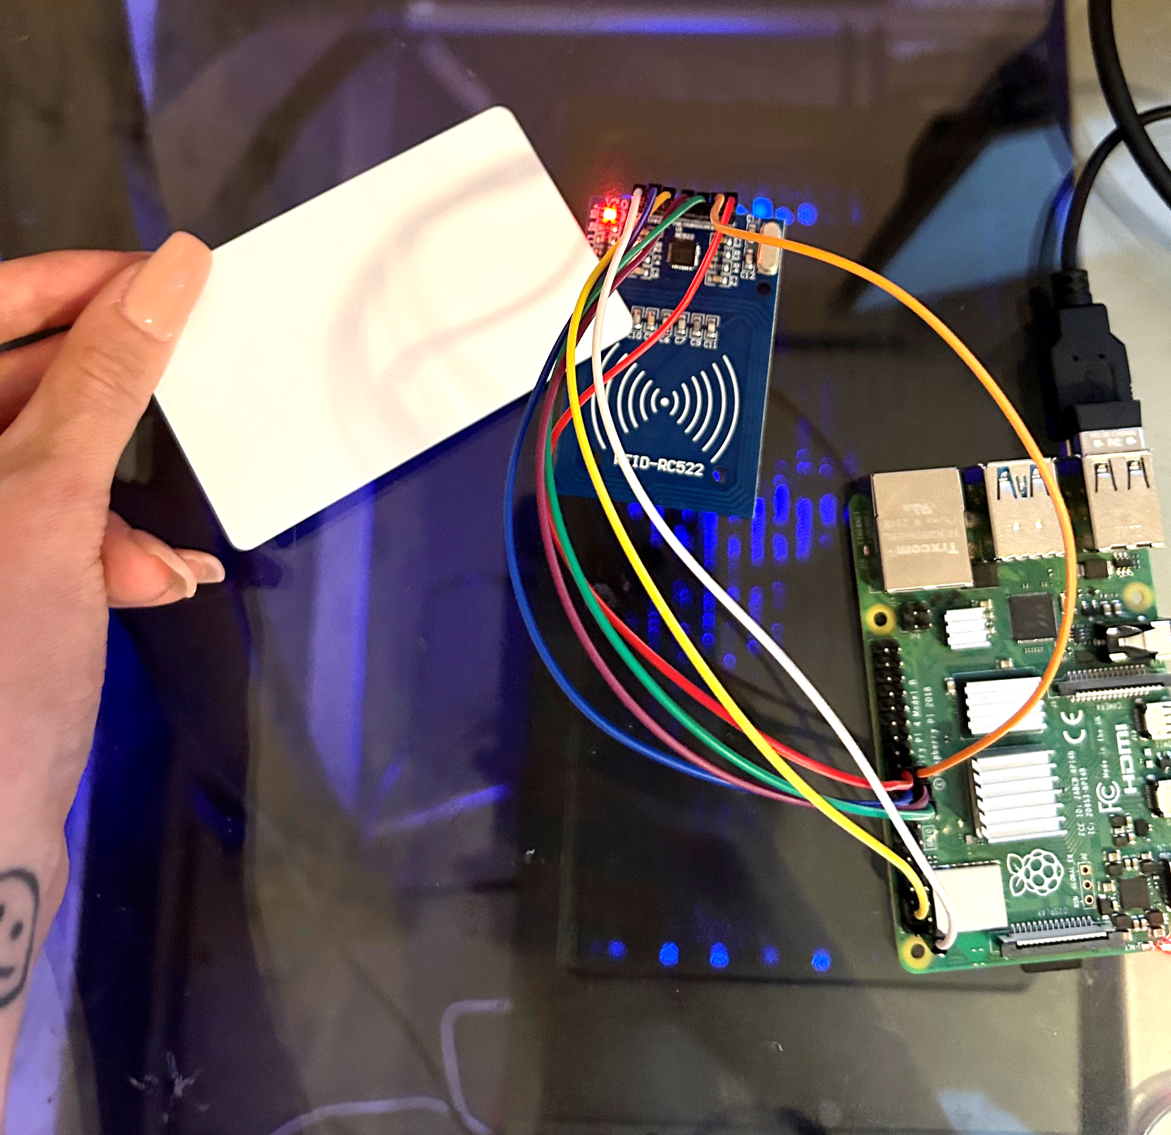



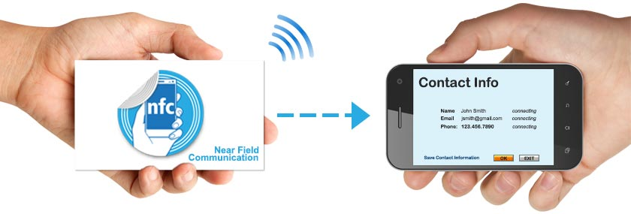

Contactless Information Card
SHARE INFORMATION WITH JUST A TAP
Tap the card to
reader to initiate
writing
.
Write information
onto the digital card.
Share information by tapping mobile devices!
Customizable digital cards
Eliminates the need for paper copies
Allows the quick, contactless transfer of contact details
Why RFID?
Because RFID tags can be read remotely and simultaneously, eliminating the need for direct line-of-sight to be detected.
Write contents such as contact information, crucial medical information, emergency contacts, special health restrictions, etc.
https://github.com/ksu-is/reader_micropython-mfrc522-1.git
Nina Lam

